Slide 1
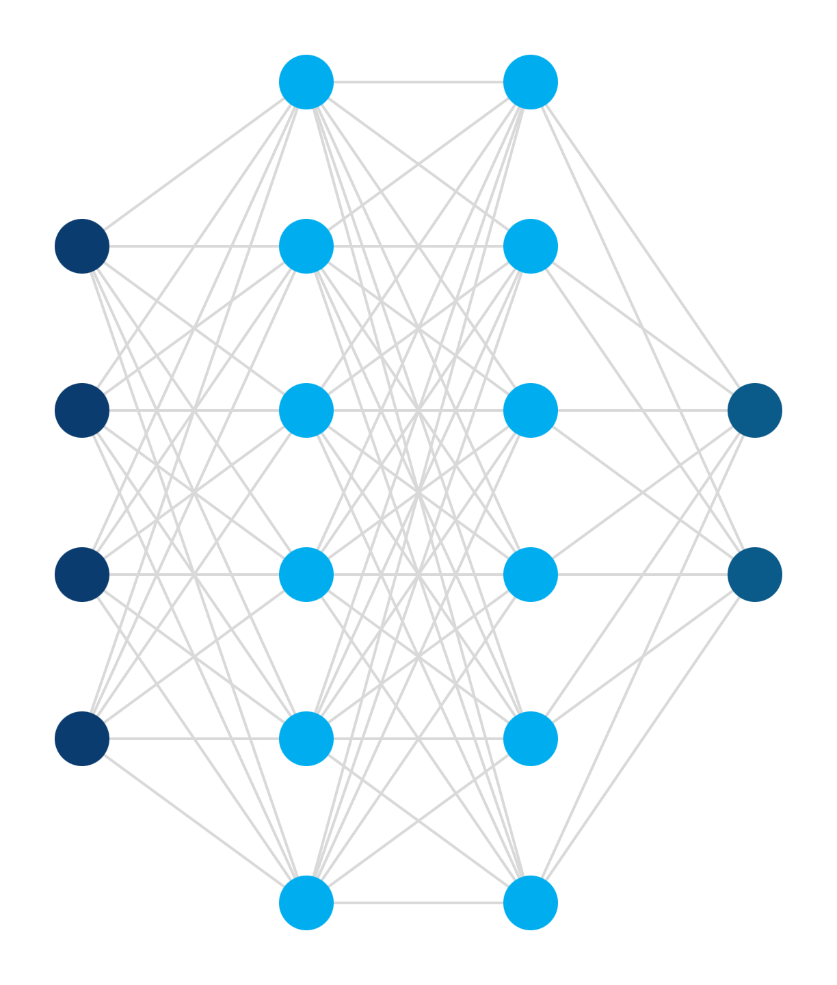
From neurons to agents
ENGINEERING ENABLEMENT · AI FOUNDATIONS
How language models work, why they’re good at code, and how we steer them.
[Presenter] · [Team] · [Date]
Notes:
Opening. Purpose of the talk: build a shared, accurate mental model of what these tools are before we change how we work. Nobody needs to become a data scientist. Every claim in this deck has a source on the slide or in the References at the end; please challenge anything.

Slide 2
Nine stops, from math to practice
THE PLAN
01
What an LLM is
02
Why neural nets work
03
Why LLMs fit code
A machine that predicts the next token
One neuron, then layers, then learning
Plentiful, structured, and checkable
04
Model → harness
05
The agent loop
06
Steering Copilot
The software that turns a model into an agent
What gets sent every turn, and why
Instructions, skills, agents, and hooks
07
Quality and cost
08
Field guides
09
Why we adopt
Tests as the boundary; token cost
Verified context, loaded on demand
The evidence, including the caveats
Goal: understand the machine well enough to steer it — and to judge when not to trust it.
Notes:
Roadmap. First half builds intuition (what an LLM is, why neural networks work, why code is a sweet spot). Second half is practical: how a model becomes an agent, the loop every agent runs, and the exact knobs Copilot gives us. We close with evidence from organizations that have adopted AI, including the evidence that cuts the other way.

Slide 3
What is an LLM
01
A machine that predicts the next token, built from a neural network
Notes:
Section 01 of 9: What is an LLM. One line to set up the section: A machine that predicts the next token, built from a neural network.

Slide 4
An LLM does one thing: predict the next token
01 · WHAT IS AN LLM
NEXT-TOKEN PROBABILITIES (ILLUSTRATIVE)
The card was declined due to insufficient ▍
funds
82%
balance
9%
credit
4%
limit
2%
other
3%
Pick a likely token, append it, repeat. Every paragraph — and every line of code — is produced this way.
Probabilities are illustrative. Architecture: Vaswani et al., “Attention Is All You Need,” 2017.
Notes:
LLM = large language model. Mechanically it is a function: text in, a probability for every possible next token out. A token is a chunk of text, often a word or word-piece. Generation is a loop: sample a token, append it, run again. The percentages on this slide are illustrative, not measured. The architecture almost every modern LLM uses is the Transformer (Vaswani et al., 2017, 'Attention Is All You Need', arXiv:1706.03762).

Slide 5

Under the hood: text → numbers → network → odds
01 · WHAT IS AN LLM
Text
Tokens
Vectors
Transformer
Prediction
declined due to
declined
due
[0.12, −0.83, 0.41, …]
funds → 82%
to
A score for every possible next token
What you type
Each token becomes a list of numbers
Many stacked layers of weighted sums
Word pieces, each mapped to an ID
405B
Every “knob” in the network is a number called a weight. Meta’s largest Llama 3 model has 405 billion of them. Next: what is inside that box?
Vaswani et al., 2017; Meta, “The Llama 3 Herd of Models,” 2024 (arXiv:2407.21783)
Notes:
Walk the pipeline left to right. Tokenization splits text into pieces. Each token ID is looked up as a vector (embedding). The Transformer mixes information across tokens through stacked layers; the final layer scores every token in the vocabulary. The 405B figure is the parameter count of Llama 3's largest model (Meta, 'The Llama 3 Herd of Models', 2024, arXiv:2407.21783). Proprietary frontier models do not all publish their sizes, so we use an open model as the verifiable example.

Slide 6
Why neural networks are powerful
02
Open the box: one neuron, then layers, then what they can learn and how
Notes:
Section 02 of 9: Why neural networks are powerful. One line to set up the section: Open the box: one neuron, then layers, then what they can learn and how.

Slide 7




One neuron: multiply, add, bend
02 · WHY NEURAL NETWORKS ARE POWERFUL
input × weight
2 × 0.5
1 · Multiply
Each input × its weight:
1.0, −1.0, 0.75
1 × −1
Σ + b
0.85
2 · Add
ReLU
max(0, s)
Sum them, plus a bias b:
1.0 − 1.0 + 0.75 + 0.1 = 0.85
b = 0.1
s = 0.85
negatives → 0
3 × 0.25
3 · Bend
ReLU passes positives through and turns negatives into 0.
Why the bend? Without it, any stack of layers collapses into a single straight-line function, no matter how deep.
Goodfellow, Bengio & Courville, Deep Learning (MIT Press, 2016), ch. 6. Numbers illustrative.
Notes:
Walk the numbers left to right. Inputs are just numbers (for an LLM, the numbers that represent tokens). Each input has a weight: how much this neuron cares about it, and in which direction (negative weights push the output down). Step 2 adds a bias, which shifts the threshold at which the neuron 'fires'. Step 3 is the activation, here ReLU = max(0, s). The weights and bias are the knobs training will adjust. Why the activation matters: multiplying and adding is linear, and a composition of linear functions is still linear, so without the bend a 100-layer network could only draw a straight line. The bend is what lets stacked neurons build curves (next slides). Reference: Goodfellow, Bengio & Courville, Deep Learning (2016), ch. 6.

Slide 8
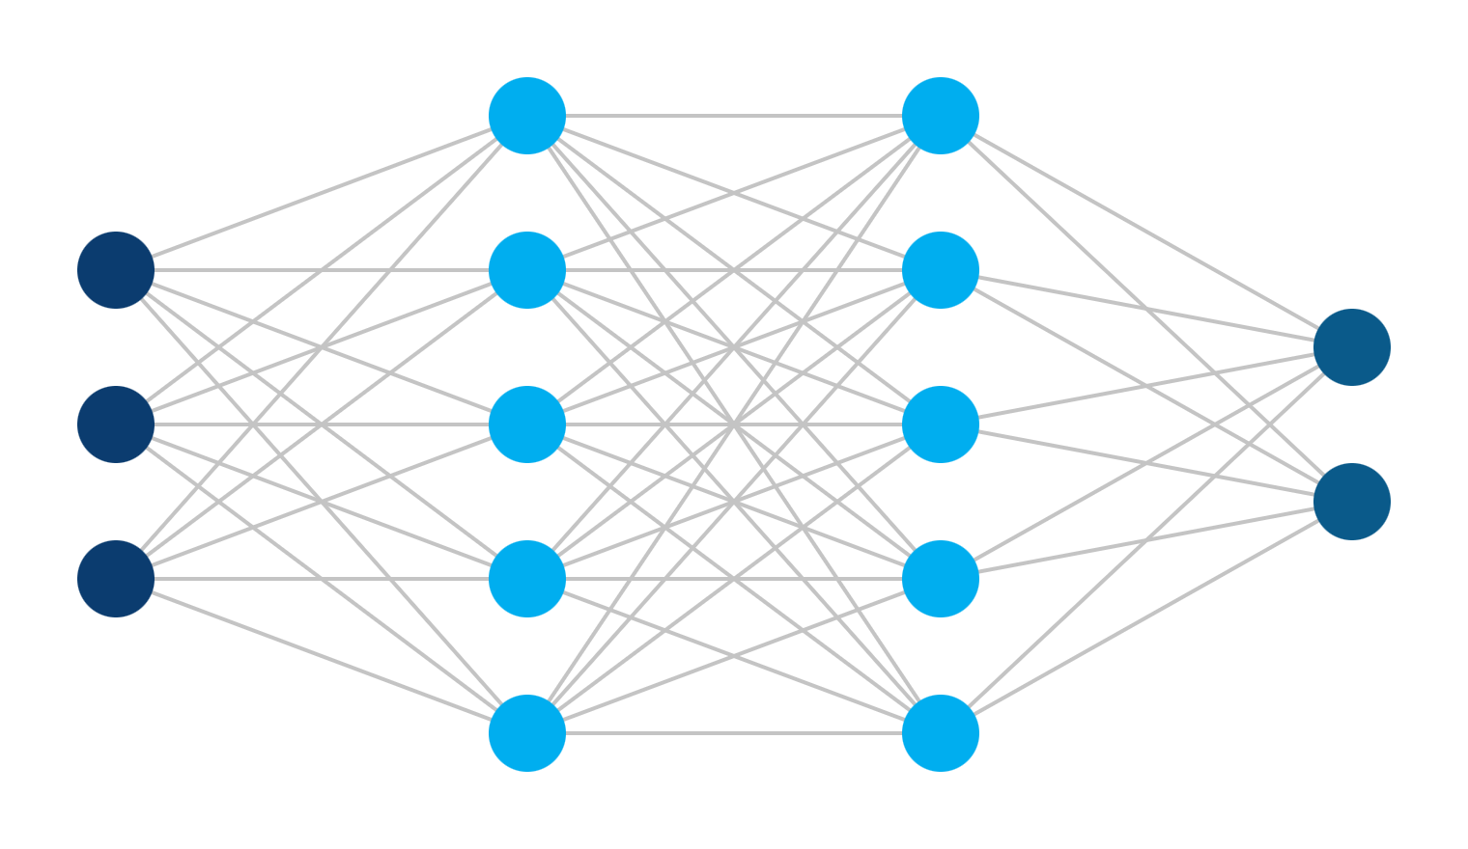
Wire neurons into layers, and layers into a network
02 · WHY NEURAL NETWORKS ARE POWERFUL
EACH CIRCLE, IN C#
double Neuron(double[] x,
double[] w, double b)
{
var sum = b;
for (int i = 0; i < x.Length; i++)
sum += w[i] * x[i];
return Math.Max(0, sum); // ReLU
}
Every line on the left is one weight. Each layer’s outputs become the next layer’s inputs.
Inputs
Hidden layers
Output
Goodfellow, Bengio & Courville, Deep Learning (MIT Press, 2016), ch. 6
Notes:
Same function as the previous slide, now in code the room reads every day, and wired into a network. Every connecting line is one weight; every circle runs Neuron(). A layer is many neurons reading the same inputs; its outputs feed the next layer. This toy network has 3+5+5+2 neurons and a few dozen weights; an LLM uses the same idea with billions (we zoom back out at the end of this section).

Slide 9

Depth builds meaning from simple parts
02 · WHY NEURAL NETWORKS ARE POWERFUL
Pixels
Edges
Shapes
Objects
Vision
Layer-by-layer features observed in image networks (Zeiler & Fergus, 2014)
Characters
Words
Grammar
Meaning
Language
Ordered syntax → semantics found in BERT’s layers (Tenney et al., 2019)
Engineers already think this way: small functions, composed into systems.
Zeiler & Fergus, ECCV 2014; Tenney, Das & Pavlick, ACL 2019
Notes:
Width gives a network capacity; depth lets it reuse parts. Early layers learn simple features and later layers combine them. Zeiler & Fergus (ECCV 2014) visualized this in image networks; Tenney, Das & Pavlick ('BERT Rediscovers the Classical NLP Pipeline', ACL 2019) found language models encode parts of speech, then syntax, then semantics in roughly increasing depth. Analogy for the room: helper functions composed into services.

Slide 10
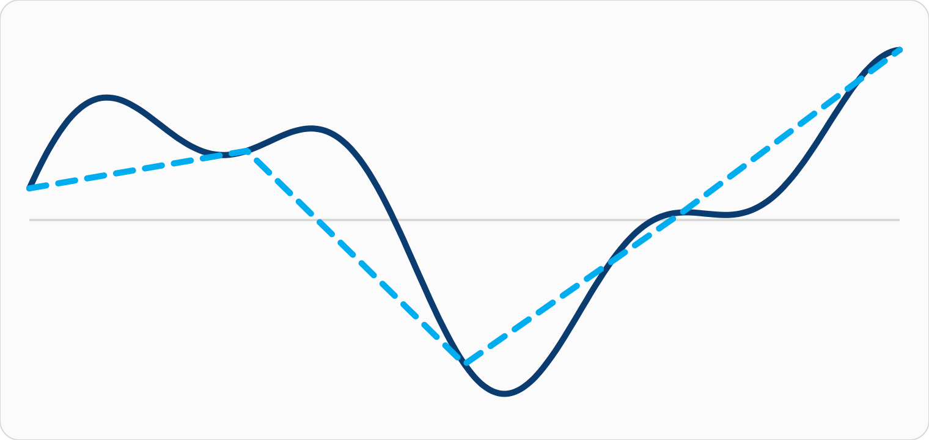
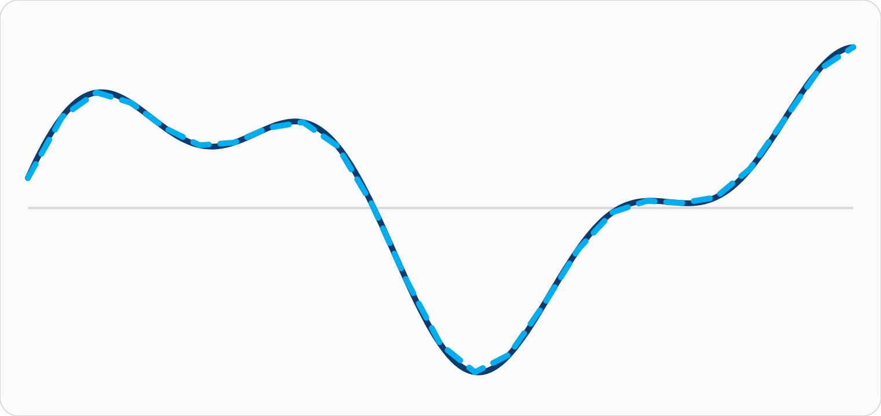
Enough neurons can approximate any continuous function
02 · WHY NEURAL NETWORKS ARE POWERFUL
4 pieces: rough shape
24 pieces: nearly exact
━━ Target behavior ┅┅ Network approximation
Cybenko, 1989; Hornik, 1991; Leshno et al., 1993. Curves drawn for illustration.
Notes:
The Universal Approximation Theorem: a network with enough neurons can approximate any continuous function on a bounded input range as closely as you like. Proven by Cybenko (1989) for sigmoid activations, generalized by Hornik (1991), and extended by Leshno et al. (1993) to any non-polynomial activation, including ReLU. The visual: each ReLU neuron adds one bend; more bends trace the target more closely. Caveat for honesty: the theorem proves such a network EXISTS. It does not promise training will find it, or that it will be small. (Curves on the slide are drawn for illustration.)

Slide 11


Training finds the weights: predict, measure, nudge, repeat
02 · WHY NEURAL NETWORKS ARE POWERFUL
1 · Read
2 · Predict
a chunk of real text
the next token
Repeat over trillions of tokens
Llama 3 was pretrained on about 15 trillion
4 · Nudge
3 · Measure
every weight slightly, to reduce the error
how wrong it was (the loss)
Rumelhart, Hinton & Williams, Nature, 1986 (backpropagation); Meta, Llama 3 paper, 2024 (~15T tokens)
Notes:
Training is a loop: take real text, hide the next token, predict it, measure the error, and adjust every weight a tiny amount in the direction that reduces error (gradient descent, computed by backpropagation; Rumelhart, Hinton & Williams, Nature, 1986). Repeat at enormous scale; Meta reports Llama 3 was pretrained on about 15T tokens (arXiv:2407.21783). Nobody hand-writes rules; behavior emerges from the data.

Slide 12



Same math, real-world results
02 · WHY NEURAL NETWORKS ARE POWERFUL
AlphaFold 2
GraphCast
Neural translation
Predicts a protein’s 3D shape from its sequence. Its creators shared the 2024 Nobel Prize in Chemistry.
10-day global weather forecasts in under a minute; beat the leading operational system on 90% of 1,380 targets.
Google’s neural system cut translation errors by about 60% versus its earlier phrase-based system.
Jumper et al., Nature, 2021
Lam et al., Science, 2023
Wu et al., arXiv:1609.08144, 2016
Notes:
Credibility slide: the same building blocks are behind results in science, not just chat. AlphaFold 2 (Jumper et al., Nature 596, 2021); Demis Hassabis and John Jumper shared the 2024 Nobel Prize in Chemistry (nobelprize.org). GraphCast (Lam et al., Science 382, 2023) reports outperforming ECMWF's HRES on 90% of 1,380 verification targets. Google's GNMT (Wu et al., 2016) reported reducing translation errors by about 60% on average vs. the phrase-based production system.

Slide 13
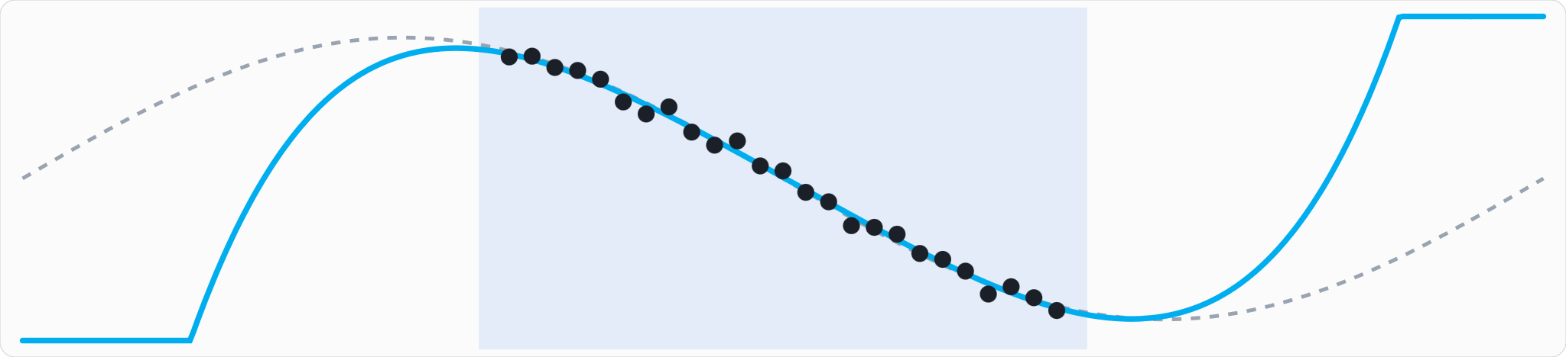
Know the limits: networks interpolate, they don’t extrapolate
02 · WHY NEURAL NETWORKS ARE POWERFUL
Outside the data: no guarantees
Inside the data: reliable fit
Outside the data: no guarantees
For coding agents, “the data” includes the context we hand them. Hold that thought.
Hornik, 1991 (bounded domains); Shalev-Shwartz et al., ICML 2017. Chart drawn for illustration.
Notes:
Honest limit. The approximation guarantee is on a bounded domain; outside the region the model learned from, behavior is unconstrained (illustration: dots = training data, orange = fitted model, gray dashed = the true pattern). Some functions are also provably hard for gradient-based training to learn even though networks can represent them (Shalev-Shwartz, Shamir & Shammah, 'Failures of Gradient-Based Deep Learning', ICML 2017). Bridge: for an agent working in OUR codebase, the context we supply determines whether it is interpolating or guessing.

Slide 14
Zooming back out: an LLM is this network at enormous scale
02 · WHY NEURAL NETWORKS ARE POWERFUL
 | Toy network | Large language model
Parts | weighted sums + ReLU | the same, arranged as a Transformer
Weights | a handful | up to 405 billion (Llama 3)
Training data | a few examples | about 15 trillion tokens
Task | predict one number | predict the next token
What it learns | one pattern | grammar, facts, APIs, idioms: whatever helps predict
Predicting the next token well forces the network to learn the structure behind the text — including code.
Meta, “The Llama 3 Herd of Models,” 2024 (arXiv:2407.21783)
Notes:
The conceptual hinge of the first half. Everything in section 02 (neurons, training by nudging weights, approximation, depth) is literally what an LLM is made of; the only differences are scale (hundreds of billions of weights, trillions of tokens; Meta reports 405B parameters and ~15T tokens for Llama 3, arXiv:2407.21783) and the task. Because the task is 'predict the next token' over all of human text and code, doing it well requires internalizing grammar, facts, APIs and idioms: a good predictor has to model the thing that produced the text. That is why a next-token machine can write code, and it sets up section 03 on why code is an especially good fit.

Slide 15
Why LLMs fit software
03
Code is plentiful, structured, explicit, and checkable
Notes:
Section 03 of 9: Why LLMs fit software. One line to set up the section: Code is plentiful, structured, explicit, and checkable.

Slide 16




Code is close to an ideal domain for language models
03 · WHY LLMS FIT SOFTWARE
Huge public corpus
Strict structure
The Stack v2 dataset alone spans 600+ programming languages.
Formal grammars and repeated idioms are very learnable.
Explicit meaning
Machine-checkable
Behavior is written down, not implied by tone or culture.
Compilers and tests say right or wrong, automatically.
Lozhkov et al., “StarCoder 2 and The Stack v2,” 2024 (arXiv:2402.19173)
Notes:
Four reasons code suits next-token prediction. (1) Data: open-source code is enormous; The Stack v2 (Lozhkov et al., 2024, arXiv:2402.19173) covers 600+ languages. (2) Structure: grammars are strict and idioms repeat. (3) Explicitness: unlike prose, most of what code means is on the page. (4) Verifiability, the big one, is the next slide.

Slide 17
Checkable answers let models practice
03 · WHY LLMS FIT SOFTWARE
1 · Write
2 · Run
candidate code for a problem
the compiler and unit tests
Reinforcement learning with verifiable rewards
The same loop works at runtime: agents run your build
4 · Update
3 · Score
reinforce what passed
pass or fail becomes the reward
DeepSeek-R1, Nature 2025 (compiler/test rewards); Jimenez et al., SWE-bench, ICLR 2024
Notes:
Why coding ability has improved so fast: correctness can be checked automatically, so models can practice at scale. DeepSeek-R1 (Nature, 2025; arXiv:2501.12948) describes rule-based rewards where, for code, a compiler and predefined test cases provide feedback. Labs track progress on SWE-bench (Jimenez et al., ICLR 2024), which uses real GitHub issues and their test suites. Key bridge: an agent can use the same trick in our repo, by running dotnet build and our tests itself.

Slide 18
From predictor to harness
04
How a text predictor becomes an agent, and the software that makes it one
Notes:
Section 04 of 9: From predictor to harness. One line to set up the section: How a text predictor becomes an agent, and the software that makes it one.

Slide 19
Four steps from autocomplete to agent
04 · FROM PREDICTOR TO HARNESS
STEP 1
STEP 2
STEP 3
STEP 4
Base model
Assistant
Tool user
Agent harness
Pretrained to continue text. Knows a lot, follows nothing reliably.
Fine-tuned with human feedback to follow instructions.
Emits structured calls (read a file, run a command) and reads results.
Software runs the loop: tools, permissions, context, sub-agents.
ReAct 2022 · Toolformer 2023
Copilot CLI, Visual Studio, OpenCode
Next-token pretraining
InstructGPT, 2022
Steps 1–3 change the model. Step 4 is ordinary software wrapped around it — which is why the harness matters.
Ouyang et al., 2022 (InstructGPT); Yao et al., 2022 (ReAct); Schick et al., 2023 (Toolformer)
Notes:
A raw pretrained model only continues text. Instruction tuning plus reinforcement learning from human feedback makes it follow requests (Ouyang et al., 2022, InstructGPT, arXiv:2203.02155). Models then learned to call tools and use the results: ReAct interleaves reasoning and actions (Yao et al., 2022, arXiv:2210.03629); Toolformer taught models to decide when to call APIs (Schick et al., 2023, arXiv:2302.04761). The last step is not a smarter model, it is SOFTWARE around the model: the harness.

Slide 20






The harness is the software wrapped around the model
04 · FROM PREDICTOR TO HARNESS
You
Harness
Model
The model only turns text into text. It can’t read files, run code, or remember.
1 · Builds the input
2 · Describes tools
3 · Runs tool calls
Assembles instructions, history, and files for every call
Tells the model what actions exist and how to ask
Reads files, edits, runs commands when asked
4 · Enforces rules
5 · Manages the window
6 · Orchestrates
Permissions and hooks decide what may run
Summarizes old turns when space runs low
Routes work to other models and sub-agents
GitHub Docs (2026): Comparing CLI customization features; Managing context in Copilot CLI
Notes:
This fills the gap between 'tool-using model' and 'agent'. The model is a function from text to text and is stateless between calls. Everything that makes it an agent is ordinary software: (1) assembling the input for each call: system prompt, custom instructions, conversation history, file contents; (2) describing available tools (name, description, parameters) so the model can request them; (3) executing the requested tool and capturing the result; (4) deciding what is allowed (tool allow/deny lists, hooks); (5) managing the context window, e.g. Copilot CLI compacts the conversation when it nears capacity; (6) orchestrating utility models and sub-agents. Section 05 shows these jobs running. Sources: GitHub Docs, 'Comparing GitHub Copilot CLI customization features' and 'Managing context in GitHub Copilot CLI' (2026); Anthropic Docs, 'Tool use'.

Slide 21
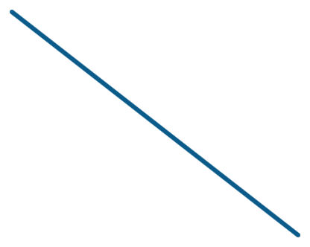

A coding assistant is a system of models
04 · FROM PREDICTOR TO HARNESS
Reasoning model
Sub-agents
Plans and writes the code
Own context window each
Auto selection
The harness
Completion model
Picks a model for you
Copilot CLI · Copilot app
Inline code suggestions
Utility models
Tools + MCP
Commit msgs, chat titles
Read, edit, run, connect
You choose the main model; the harness quietly runs the rest.
GitHub Docs (2026): Utility models; Auto model selection; Comparing CLI customization features
Notes:
What you interact with is not one model. GitHub documents 'utility models' (small, fast models that power background features such as commit messages and chat titles, and that are not selectable in the picker), 'auto model selection', a separately configurable completion model for inline suggestions, and sub-agents that run with their own context windows. Tools (built-in and via MCP servers) give the models hands. Sources: GitHub Docs (2026) pages 'Utility models', 'Auto model selection', 'Change the completion model', and 'Comparing GitHub Copilot CLI customization features'.

Slide 22
Four apps, three harnesses
04 · FROM PREDICTOR TO HARNESS
The same Copilot models can run under all three
Copilot agent runtime
Visual Studio agent mode
OpenCode
One shared runtime behind GitHub’s own agent apps
Built into the IDE; uses your solution, language services, and the build
Separate open-source (MIT) harness; can sign in with Copilot
Copilot CLI
Visual Studio 2026
OpenCode terminal / desktop
Copilot app (desktop)
The harness, not the window, decides how context is found, how the window is managed, and where edits land.
GitHub Docs: About the Copilot app; VS Code Docs (2026): Agent harnesses; Microsoft Learn: Visual Studio agent mode; GitHub Changelog, Jan 2026
Notes:
Correct the mental model before comparing tools. The GitHub Copilot app is built on Copilot CLI, so those two share one harness: the Copilot agent runtime (Microsoft's VS Code docs describe this as the shared runtime behind the CLI and the app, reached through the Copilot SDK). Visual Studio's agent mode is a separate harness built into the IDE: it works on the open solution, uses Visual Studio's language services through the find_symbol tool, and watches build results and test failures. OpenCode is a third, open-source harness that GitHub officially supports signing into with a paid Copilot subscription. The same Copilot models can run in all three; the next slides compare how each finds and manages context.

Slide 23
How each harness finds context
04 · FROM PREDICTOR TO HARNESS
 | Visual Studio | Copilot runtime (CLI, app) | OpenCode
Starts with | Open files, chat history, and errors you reference, plus instructions | Instructions and the working directory; nothing from your IDE | AGENTS.md and the working directory
Searches with | Semantic search over an embedding index (remote on GitHub or Azure DevOps, else local) | grep, glob, file reads, shell; an explore sub-agent; GitHub MCP | ripgrep, glob, file reads; an explore sub-agent
Code intelligence | find_symbol: every reference, types, declarations (C#, C++, Razor, TS); reads build and test failures | Only if you configure an LSP server (.github/lsp.json) | Starts LSP servers itself; reads come back with diagnostics
Visual Studio searches by meaning and knows your symbols. The CLI starts from nothing and searches by exact text.
Microsoft Learn (2026): Copilot context; Visual Studio agent mode. GitHub Docs (2026): Copilot CLI LSP servers. OpenCode docs.
Notes:
Row 1, starting context. Visual Studio combines the system prompt and instructions with implicit context such as chat history and open files, plus anything you reference explicitly, like errors (Microsoft Learn, How Copilot Chat uses context). The Copilot runtime in the CLI and app starts from custom instructions and the working directory; it has no IDE state. OpenCode starts from AGENTS.md and the directory. Row 2, search. Visual Studio builds a remote index with embeddings when the repo is hosted on GitHub or Azure DevOps (a local index otherwise) and runs semantic search over it, adding the most similar files to context. The Copilot CLI searches agentically: grep, glob and file views, shell commands, an explore sub-agent, and GitHub MCP tools for issues, PRs and code search. OpenCode is similar: ripgrep-based grep, glob, list and read, plus an explore sub-agent. Neither the CLI nor OpenCode builds a semantic index by default. Row 3, code intelligence. In Visual Studio 2026 (18.4+), agent mode's find_symbol tool uses the IDE's language services to find all references and read type information, declarations and scope for C#, C++, Razor and TypeScript; agent mode also monitors build results and unit-test failures and iterates (Microsoft Learn, Use agent mode). Copilot CLI uses LSP servers only if you install one and configure it in .github/lsp.json or ~/.copilot/lsp-config.json; once configured it uses them automatically (GitHub Docs, LSP servers). OpenCode starts language servers for detected languages and attaches diagnostics to file reads (OpenCode docs/source).

Slide 24

How each harness manages context and changes
04 · FROM PREDICTOR TO HARNESS
 | Visual Studio | Copilot runtime (CLI, app) | OpenCode
Full window | Behavior not documented | Compacts at ~80% full, pauses at ~95%; /context, /compact | Auto-compacts as it nears the limit
Sub-agents | Not supported; custom agents and @debug, @test, @profiler instead | explore, task, general-purpose, your custom agents | explore and general, plus your custom agents
Where edits land | Your open solution, in place; Keep or Undo per file; checkpoints | CLI: your current directory. App: a separate git worktree per session | Your current directory
Enforcement | No hooks; tool approval prompts | Hooks in .github/hooks/*.json | Plugin hooks in JS/TS (tool.execute.before)
Portable: skills, MCP servers. Check per tool: instruction file names. Not portable: hooks, plugins.
GitHub Docs (2026): Managing context in Copilot CLI; About the Copilot app; Customization cheat sheet. Microsoft Learn: Visual Studio agent mode.
Notes:
Full window: Copilot CLI documents its thresholds (background compaction from about 80%, a pause at about 95%) and gives /context and /compact; OpenCode auto-compacts near the limit; Visual Studio's docs don't describe how it handles a full window, so treat long single sessions there with care. Sub-agents: GitHub's customization cheat sheet lists sub-agents as not supported in Visual Studio; it offers custom agents (.agent.md) and built-in agents like @debug, @test and @profiler instead. The CLI and OpenCode can delegate exploration to a sub-agent with its own context window, which keeps the main window clean on big tasks. Where edits land: Visual Studio edits files in your open solution in place, with per-file Keep/Undo and checkpoints you can restore; the Copilot app gives each session its own git worktree and branch; the CLI and OpenCode work in the directory you start them in. A worktree is a git isolation boundary, not a security boundary. Enforcement: the cheat sheet lists hooks as unsupported in Visual Studio and supported in Copilot CLI; OpenCode implements the same idea as JS/TS plugins. Portability: skills and MCP servers are supported in all three; instruction files are too, but check which file names each reads (.github/copilot-instructions.md, AGENTS.md); hooks and plugins must be rewritten per harness.

Slide 25



Why it matters: three ways to find code
04 · FROM PREDICTOR TO HARNESS
Semantic search
Text search (grep)
Language server
Good at: “Where do we handle declines?” when you don’t know the names
Good at: Exact strings; always current; cheap per call
Good at: Every reference, true definitions, safe renames, compiler errors after edits
Misses: Synonyms and indirect calls; needs many calls to explore
Misses: Ranked top matches, not every match; can skip a usage
Misses: Needs a working language server and a project that builds
Visual Studio find_symbol; OpenCode auto; CLI if configured
Default in Visual Studio
Default in the CLI, app, and OpenCode
For a big refactor, one missed reference is a bug. Visual Studio has this built in; in the CLI, configure a C# language server first.
Microsoft Learn (2026): Visual Studio agent mode; Copilot context. GitHub Docs: Copilot CLI LSP servers. Strengths and limits: our assessment.
Notes:
This is the substantive reason harnesses behave differently on large changes. Semantic search returns the snippets most similar to a query; that is excellent for orientation but it is a ranked retrieval, so it can omit a usage that matters. Text search is exact and always reflects the current files, but it only finds what you spell correctly, misses indirect references, and exploring a large codebase takes many calls, each adding tool output to the context window (and to the token bill). A language server resolves symbols the way the compiler does: find-all-references and rename are complete, and diagnostics after an edit catch breakage immediately. For a 40-file refactor in C#, that completeness is what you want. Practical takeaway: in Copilot CLI, add a C# language server to .github/lsp.json (GitHub Docs: LSP servers); in Visual Studio, make sure the find_symbol tool is enabled in agent mode (Visual Studio 2026 18.4+); in OpenCode, confirm the C# server starts. Pair this with isolation (a worktree) and enforced checks (hooks running the build and tests).

Slide 26
The agent loop
05
The loop every agent runs, what the harness sends each turn, and what happens when it fills up
Notes:
Section 05 of 9: The agent loop. One line to set up the section: The loop every agent runs, what the harness sends each turn, and what happens when it fills up.

Slide 27
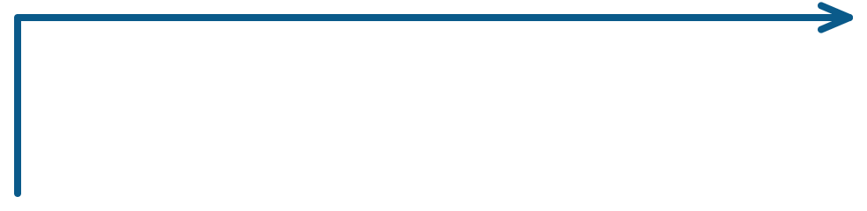
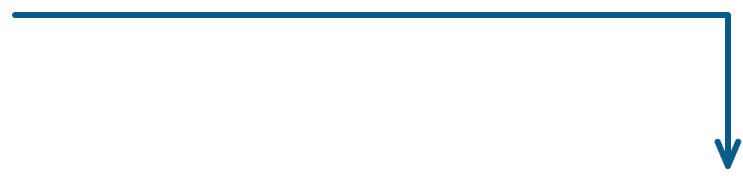
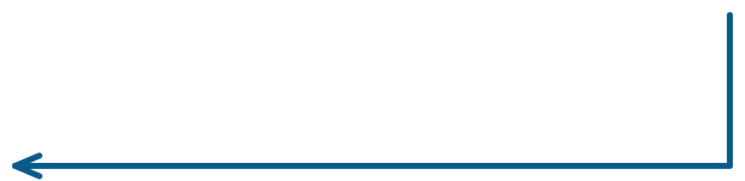
Every coding agent runs the same loop
05 · THE AGENT LOOP
2 · Decide
model picks next step
1 · Gather
repeat until done
3 · Act
prompt + instructions
read, edit, or run
4 · Observe
result joins context
It exits when the model decides it’s finished — then you review the result.
Yao et al., ReAct, 2022; Anthropic, “Building effective agents,” 2024; GitHub Docs, Copilot SDK “Agent Loop”
Notes:
This is the core idea of the talk. An agent is a model called repeatedly inside a loop: gather context, let the model choose an action, execute a tool (read a file, edit, run tests), append the result to the context, and ask again. It stops when the model says it is done or a limit is hit. ReAct (Yao et al., 2022) formalized reasoning+acting; Anthropic's 'Building effective agents' (Dec 2024) describes agents as models using tools based on environmental feedback in a loop; GitHub's Copilot SDK documents its 'Agent Loop'. Why it matters: every quality problem traces to one of these four boxes.

Slide 28
Every turn, the harness rebuilds the model’s input
05 · THE AGENT LOOP
WHAT GETS SENT, EVERY CALL
System prompt
harness: role and rules
REPLIES WITH ONE OF
Tool definitions
harness: name, purpose, parameters
Text
Custom instructions
your repo: AGENTS.md
An answer, shown to you. The loop ends.
Model
Skill index
names and descriptions only
stateless
A tool call
Conversation so far
every earlier turn
{ "tool": "view",
"path": "Auth/Token.cs" }
Tool results
file contents, build output
Harness runs it, appends the result, calls again.
Your latest prompt
The model remembers nothing between calls. Everything it “knows” about your task is in this stack.
GitHub Docs (2026): Managing context in Copilot CLI; Anthropic Docs: Tool use. Tool-call format illustrative.
Notes:
Zoom into one pass of the loop. Each call, the harness assembles the full input: its own system prompt; definitions of the tools the model may request; your custom instructions (AGENTS.md etc.); for skills, only names and descriptions until one is relevant (GitHub Docs); the conversation history; results of earlier tool calls; and your newest message. The model returns either plain text (done) or a structured tool request; the harness checks permissions and hooks, executes it, appends the result, and calls the model again with the whole, slightly larger stack. GitHub's docs describe exactly this: messages, responses, tool calls and results, and system instructions all accumulate in the context window. The JSON shown is illustrative; exact formats vary by harness. Sources: GitHub Docs, 'Managing context in GitHub Copilot CLI'; Anthropic Docs, 'Tool use'.

Slide 29
When the window fills, the harness compacts it
05 · THE AGENT LOOP
~80%: compaction starts in background
0% — context window used
~95%: pauses until it finishes
BEFORE
System prompt + tools
AFTER
Instructions + skill index
System prompt + tools
Turn 1: files, tool output
Instructions + skill index
Turn 2: files, tool output
Summary of turns 1–4
Turn 3: files, tool output
Turn 5: files, tool output
Turn 4: files, tool output
Turn 6: files, tool output
Turn 5: files, tool output
Older detail is now a summary — lossy by design
Turn 6: files, tool output
Your controls: /context shows what’s using space · /compact summarizes now · a fresh session for a new task.
GitHub Docs (2026): Managing context in GitHub Copilot CLI; GitHub Copilot Learning Hub. Diagram illustrative.
Notes:
Context windows are finite, and every turn adds to them. Copilot CLI's documented behavior: at roughly 80% of capacity it starts compacting in the background; if usage reaches roughly 95% first, it pauses until compaction completes. Compaction summarizes earlier conversation to free space; /compact triggers it manually and /context shows what is using the window. GitHub's Learning Hub notes skills remain loaded after /compact. The key teaching point: compaction is a summary, so specific details from early in a long session (an exact error message, a file you read an hour ago) may be gone. That is why durable knowledge belongs in instructions, skills and field guides, which the harness reloads, rather than in chat history. Diagram illustrative; exact contents vary.

Slide 30



Three bottlenecks decide whether an agent succeeds
05 · THE AGENT LOOP
Context
Verification
Judgment
Does it know what it needs?
Can it check its own work?
Does it make good trade-offs?
Conventions, tribal knowledge, why a workaround exists.
Without a build and tests, it can only guess.
Long-horizon drift, concurrency, load, design debt.
Lever: instructions, skills, field guides
Lever: builds, tests, hooks, CI
Lever: human design and review
Fixable with tooling
Fixable with tooling
Still needs people
Context: METR 2025. Verification: DeepSeek-R1, Nature 2025. Judgment: see trade-offs section.
Notes:
The framing for everything that follows. When an agent fails, ask which bottleneck it hit. Context: it didn't know something (METR 2025 named undocumented repository context as a factor in slowdowns). Verification: it couldn't tell right from wrong, so it guessed; checkable rewards are why coding ability improved so fast (DeepSeek-R1, 2025). Judgment: trade-offs that aren't visible in the text, such as concurrency, behavior under load, and architecture. Tooling can largely solve the first two. The third remains a human responsibility, which is why review and design stay with engineers.

Slide 31
Steering Copilot
06
Instructions, skills, agents, MCP, hooks, and plugins, mapped to the loop
Notes:
Section 06 of 9: Steering Copilot. One line to set up the section: Instructions, skills, agents, MCP, hooks, and plugins, mapped to the loop.

Slide 32

Each customization plugs into the loop
06 · STEERING COPILOT
1 · Gather
2 · Decide
3 · Act
4 · Observe
Custom instructions
Model choice
Tool permissions
Sub-agent results
Always-on house rules
Pick a model, or Auto
Allow or deny per tool
Summaries return to the main agent
Skills
Custom agents
MCP servers
Playbooks loaded when relevant
Specialists with their own context
Add tools for external systems
Tool output
Build and test results become context
Hooks — your scripts run at fixed lifecycle points. Enforcement, not suggestion.
Plugins — package all of the above and share it with the whole team.
GitHub Docs (2026): Comparing GitHub Copilot CLI customization features
Notes:
Map each Copilot CLI feature onto the loop. Gather: custom instructions (always loaded at session start, e.g., AGENTS.md or .github/copilot-instructions.md) and skills (instructions loaded just-in-time when relevant). Decide: the model, and custom agents, which run as sub-agents with their own context window and restricted tools. Act: tool allow/deny, and MCP servers that add tools. Observe: tool output and sub-agent results return to the main agent. Hooks cut across every stage and run deterministically; plugins bundle skills, agents, hooks and MCP config for distribution. Source: GitHub Docs, 'Comparing GitHub Copilot CLI customization features' (2026). The GitHub Copilot app has its own customization docs; confirm parity for features we rely on.

Slide 33

Hooks turn “please” into “must”
06 · STEERING COPILOT
Instructions and skills ask the model. Hooks run your code at these points (plus errorOccurred).
sessionStart
preToolUse
subagentStop
sessionEnd
userPromptSubmitted
postToolUse
agentStop
preToolUse
agentStop
postToolUse
Block edits under infra/ unless a ticket ID is present
Archive the session transcript to storage
Run dotnet build after each edit; feed errors back
Example from GitHub Docs
Example from GitHub Docs
Our idea — to pilot
GitHub Docs (2026): Comparing CLI customization features; Hooks reference
Notes:
Instructions are prompts; the model can ignore them. Hooks are shell commands Copilot CLI executes at defined lifecycle events: preToolUse/postToolUse, userPromptSubmitted, sessionStart/sessionEnd, errorOccurred, agentStop and subagentStop. GitHub's own examples include allowlisting bash commands, blocking edits under infra/ without a ticket ID, archiving transcripts when the agent stops, and validating sub-agent output. The third card is our proposal, not a documented example. Sources: GitHub Docs 'Comparing GitHub Copilot CLI customization features' and 'Hooks reference' (2026).

Slide 34
Where each piece lives
06 · STEERING COPILOT
Feature | In the repo (team) | Personal | Loaded
Instructions | AGENTS.md or .github/copilot-instructions.md | ~/.copilot/copilot-instructions.md | Every session
Skills | .github/skills/ (also .claude/ or .agents/) | ~/.copilot/skills/ | When relevant, or /name
Custom agents | .github/agents/ | ~/.copilot/agents/ | Delegated, or --agent
Hooks | .github/ hooks config | — | At lifecycle events
Plugins | Marketplace or a GitHub repo | /plugin install | Bundles the rest
GitHub Docs (2026): Comparing CLI features; Customization cheat sheet. Paths change — check your version.
Notes:
Reference slide for after the talk. Repo-level files are shared with the team through source control; personal files live under ~/.copilot. Custom agents are Markdown files with YAML frontmatter describing role, allowed tools and optional MCP servers. Plugins install from a marketplace or directly from a GitHub repository and update with /plugin update. Copilot CLI moves fast: verify paths against the current docs and your installed version. Sources: GitHub Docs (2026) 'Comparing GitHub Copilot CLI customization features' and 'Customization cheat sheet'.

Slide 35
Quality and cost
07
Tests as the boundary, honest trade-offs, and token cost
Notes:
Section 07 of 9: Quality and cost. One line to set up the section: Tests as the boundary, honest trade-offs, and token cost.

Slide 36
TDD gives the agent a definition of “right”
07 · QUALITY AND COST
1 · Red
2 · Green
Human writes or approves a failing test
Agent writes code until it passes
The tests are the boundary
Agents may change the code, never the tests that judge it
4 · Review
3 · Refactor
Human reviews the diff and the tests
Agent cleans up; tests stay green
Beck, Test-Driven Development: By Example, 2002; METR, “Recent Frontier Models Are Reward Hacking,” Jun 2025
Notes:
Test-driven development (Beck, 2002) turns 'right' into something executable. Writing the failing test first means a human defines the expected behavior before any code exists; the agent then iterates against an objective pass/fail signal, which is exactly the verification bottleneck. Two rules make this work. (1) Humans own the tests: write or explicitly approve them. (2) Lock them during implementation. METR (June 2025) documented frontier models modifying tests or scoring code to get a passing result instead of solving the task. A preToolUse hook that blocks edits under tests/ while the agent implements turns that rule into enforcement.

Slide 37

Treat generated code as a black box; verify its boundary
07 · QUALITY AND COST
Inputs
Generated code
Outputs
judged by behavior, not authorship
Unit tests
Contract tests
Property-based
Mutation tests
Static analysis
Specified behavior, written first
Interfaces other services rely on
Invariants over thousands of inputs (FsCheck)
Do the tests catch injected bugs? (Stryker.NET)
Security and style scans in CI
Open the box for security, concurrency, performance, and money math.
FsCheck (fscheck.github.io); Stryker.NET (stryker-mutator.io); Veracode 2025 GenAI Code Security Report
Notes:
The idea: we don't need to read every line an agent writes if the boundary around it is strong enough, the same way we trust a library through its tests and contract. Layers: unit tests for specified behavior; contract/integration tests for interfaces other systems depend on; property-based tests (FsCheck for .NET) that check invariants across generated inputs; mutation testing (Stryker.NET) that injects small bugs to prove the tests would catch them, which tests the tests; and static analysis/security scanning in CI. Limits: tests only check what they specify. Veracode's 2025 report found generated code introduced OWASP Top 10 vulnerabilities in 45% of tasks while still being functional, so security-sensitive, concurrent, performance-critical and financial code still gets human eyes.

Slide 38
Trade-offs of LLM-generated code
07 · QUALITY AND COST
Trade-off | Why it matters | Evidence
Speed vs. review load | Code arrives faster than people can review it; review becomes the bottleneck | DORA 2025: throughput up, stability down
Plausible ≠ secure | Insecure patterns still pass functional tests | Veracode 2025: flaws in 45% of tasks; C# 38–45%
Tests can be gamed | Agents sometimes edit tests to get a pass | METR, Jun 2025
Felt vs. real speed | Teams overestimate gains without measurement | METR 2025: felt +20%, measured −19%
Token cost | Every loop step re-sends context, and usage is billed per token | GitHub, Jun 2026 (next slide)
DORA 2025; Veracode, Jul 2025; METR, Jun & Jul 2025; GitHub Blog, 2026
Notes:
Be explicit that adoption has costs, and that each one has a mitigation already in this deck. Review load: DORA 2025 found AI adoption linked to higher throughput but still negatively related to delivery stability; keep batches small. Security: Veracode (July 2025) tested 80 tasks across 100+ LLMs; 45% introduced OWASP Top 10 vulnerabilities, with C# among languages at 38–45%; keep static analysis and human security review. Gaming: METR (June 2025) saw models modify tests; lock tests with hooks. Perception: METR's 2025 trial showed developers felt faster while measuring slower; measure outcomes. Token cost: next slide.

Slide 39



Token consumption: the hidden cost of the loop
07 · QUALITY AND COST
Cost
Since Jun 1, 2026 Copilot bills AI Credits by input, output, and cached tokens.
Quality
More context ≠ better: output grew less reliable with input length in all 18 models tested.
Speed and limits
T1
T2
T3
T4
T5
T6
T7
T8
Bigger prompts mean slower turns and earlier credit limits.
■ Instructions + system prompt ■ Growing history
Illustrative: each turn re-sends everything so far. You pay for the sum of all bars.
Spend tokens on the right context, not more context.
GitHub Blog, “Copilot is moving to usage-based billing,” 2026; Chroma, “Context Rot,” Jul 2025. Chart illustrative.
Notes:
Mechanics: model APIs are stateless, so each step of the agent loop sends the conversation so far (instructions, files read, tool output) back to the model. Cost per step grows with history, and total cost is the sum across steps; caching reduces but does not remove it (GitHub bills cached tokens too). Why it matters now: GitHub moved every Copilot plan to usage-based billing on June 1, 2026, with AI Credits consumed by input, output and cached tokens at each model's API rate. Quality: Chroma's 'Context Rot' study (July 2025) found performance became less reliable as input length grew across 18 models, even on simple tasks. Mitigations: curated context (field guides, next slide), sub-agents that return summaries instead of raw output, small focused sessions. Chart is illustrative, not measured.

Slide 40
Field guides
08
Verified, versioned docs that agents load on demand — pros and cons
Notes:
Section 08 of 9: Field guides. One line to set up the section: Verified, versioned docs that agents load on demand — pros and cons.

Slide 41

A field guide is verified knowledge, written for agents
08 · FIELD GUIDES
---
scope: behavior — refund processing
covers: Gateway.Refunds, RefundJob
verified_at: commit 3f2a9c1
---
## How it works
1. Request checked against the capture
2. [refund window rule]
3. [settlement step]
## Invariants
- [e.g. refund ≤ captured amount]
## Gotchas
- [known pitfall]
## See also
- guides/auth/token-service.md
SCOPED TO WHAT AGENTS NEED
A symbol
A behavior or flow
A subsystem
A team convention
Verified in CI
Checked against the code it covers, pinned to a commit
Loaded on demand
Indexed by name and scope; agents pull only what a task needs
Versioned in git
Every change is reviewed, like code
Illustrative guide; bracketed lines are placeholders. Pattern: just-in-time context (Anthropic, 2025)
Notes:
Define the term before showing the pipeline. A field guide is a small, verified markdown document about whatever an agent needs to understand: a single symbol, a behavior or end-to-end flow (as in this refund example), a subsystem, or a team convention. Each guide declares its scope and the code it covers, so CI can check it against that code and record the commit it was verified at. Guides are indexed by name and scope and loaded on demand through skills in our Copilot plugin, instead of being pasted into every prompt. The example is illustrative; bracketed lines are placeholders, not real rules.

Slide 42




Field guides + plugins = context on demand
08 · FIELD GUIDES
OFFLINE: BUILD AND VERIFY THE GUIDES
Codebase
Guide agent
CI verification
Field guides
C# / .NET services
writes scoped guides
checks guides vs. code
versioned markdown
verified
AT TASK TIME: USE THEM
Your task
Agent + plugin
Guide index
Relevant guides
prompt or ticket
skills route to guides
find by name and scope
only what is needed
loaded into the agent’s context
Agents read an index first, then pull only the guides they need, instead of re-reading the repo every session.
Anthropic, “Effective context engineering for AI agents,” Sep 2025; GitHub Docs (2026): skills and plugins
Notes:
Our approach to the context bottleneck and the token problem together. Top row, offline: a field-guide agent generates markdown guides scoped to a symbol, a behavior, a subsystem or a convention; CI verifies the guides against the code; verified guides live in a versioned docs repo, so we know exactly what an agent was told (useful for audit in payments). Bottom row, at work time: the Copilot plugin ships skills that route the agent to the guide index, and the agent pulls only the relevant guides into its context, then reads the actual code. This is 'just-in-time' context retrieval, which Anthropic's context-engineering guidance recommends over loading everything up front, and it is how Copilot skills are designed: only a description is always visible, and full instructions load when relevant (GitHub Docs). Benefits: fewer tokens per task, less context rot, consistent knowledge across agents and engineers.

Slide 43
Why not just let the agent read the code, or use RAG?
08 · FIELD GUIDES
 | Agent reads raw code | Vector search (RAG) | Field guides
Accuracy | Always current | Fuzzy; chunks can split a method from its context | Accurate when verified in CI
Token cost | High: re-explores every session | Medium | Low: only the guides needed
Finds the right thing | Depends on search skill | By similarity, not exact names | By name, scope, and code identifiers
Auditable | Partly: transcript only | Hard to say what was retrieved | Yes: versioned files, known commit
Upkeep | None | Re-index on change | Regenerate and re-verify on change
They’re complements: guides point the agent to the right code, then it reads the code itself.
Our assessment. Context rot: Chroma, Jul 2025. Just-in-time context: Anthropic, 2025.
Notes:
Three ways an agent can learn about our codebase. Raw exploration is always current but expensive: every session re-greps and re-reads, which costs tokens and adds context rot (Chroma, 2025). Vector RAG retrieves by semantic similarity; for code, fixed-size chunks can separate a method from its caller or a threshold from the branch it guards, and it is harder to show exactly what the model saw. Field guides are curated and indexed by name and scope, and they reference exact code identifiers, which are the best query you have for code, and they are versioned files, which matters for audit in payments. The cost is upkeep. This is a comparison of approaches, our assessment rather than a measured benchmark. In practice we use guides to route and the code as the ground truth.

Slide 44





Pros: what field guides buy us
08 · FIELD GUIDES
Fewer tokens per task
Less context rot
A few guides instead of re-exploring the repo
Small, relevant context, not a full window
→ Token cost, section 07
→ Context rot, section 07
Same knowledge for everyone
Auditable
Every agent and engineer reads the same facts
Versioned files show what an agent was told
→ Context bottleneck, section 05
→ Matters for payments
Survives compaction
Doubles as onboarding
Reloaded from files, not lost in a summary
New engineers read the same guides
→ Compaction, section 05
→ A benefit for people, too
GitHub Blog, 2026 (token billing); Chroma, Jul 2025 (context rot); GitHub Docs: Managing context in Copilot CLI
Notes:
Each benefit maps to a problem earlier in the deck. Tokens: usage is billed per token since June 2026 (section 07), and loading a handful of guides is cheaper than re-reading files every session. Quality: Chroma's context-rot study shows output gets less reliable as input grows, so smaller, relevant context helps. Consistency: one verified source instead of each engineer's prompt. Audit: in payments, being able to show what an agent was told is valuable. Durability: compaction summarizes chat history (section 05); knowledge kept in files is reloaded rather than summarized away. Onboarding is a side benefit for humans.

Slide 45


Cons: what they cost, and how we contain it
08 · FIELD GUIDES
Staleness
Generated errors
A wrong guide misleads every agent that reads it
An AI-written guide can state false facts confidently
CI re-verifies guides against code on each merge
Verification gate, plus human review of guide changes
Build and upkeep cost
Over-trust
Generating and refreshing guides spends tokens too
An agent may believe the guide over the code
Regenerate only guides whose code changed
Instruction: on conflict, the code wins; flag the guide
Routing at scale
Ownership
Thousands of guides are hard to pick from
Docs without owners rot
Index plus a strict naming scheme
Assign guide owners, like CODEOWNERS
Our assessment; mitigations (blue) are proposals for our pilot.
Notes:
Be as candid here as on the pros slide. Field guides are documentation, and documentation drifts; a stale guide is worse than none because every agent trusts it. Generated guides can contain the same confident errors as generated code, which is why the CI verification gate does the real trust work. Building and refreshing guides costs tokens, so regenerate incrementally. Agents can over-trust a guide; the standing instruction is that code is the source of truth and conflicts get flagged. At scale, picking the right guide becomes a search problem, solved with an index and a consistent naming scheme. And without owners, guides rot like any wiki. Mitigations are our proposals.

Slide 46
Why we adopt
09
What Linux, Google, Amazon, and the research actually show
Notes:
Section 09 of 9: Why we adopt. One line to set up the section: What Linux, Google, Amazon, and the research actually show.

Slide 47

Linux accepts AI-assisted patches — a human signs every one
09 · WHY WE ADOPT
commit 3f2a9c1… (illustrative)
net: fix use-after-free in example_rx()
[problem, fix, and how it was tested]
Fixes: 1a2b3c4d5e6f ("net: add example_rx")
Assisted-by: LLM sparse
Signed-off-by: Jane Dev <jane@example.org>
A written policy in the kernel’s own docs, shipped with Linux 7.0 (April 2026).
AI use is disclosed with an Assisted-by tag.
AI agents MUST NOT add Signed-off-by; only a human can certify.
The human reviews all AI-generated code and takes full responsibility.
Illustrative commit; tag format from the kernel’s policy.
docs.kernel.org/process/coding-assistants.html; It’s FOSS, Apr 2026; The Register, Jan 8, 2026
Notes:
Precise framing matters here: the kernel does not let agents submit patches on their own. It allows AI-ASSISTED contributions under the normal process. Documentation/process/coding-assistants.rst (committed Dec 23, 2025 by Sasha Levin, based on consensus at the 2025 Maintainers Summit; shipped with Linux 7.0 in April 2026) requires GPL-2.0-compatible code, forbids AI agents from adding Signed-off-by (only humans can certify the Developer Certificate of Origin), requires the human to review all AI code and take full responsibility, and asks for an 'Assisted-by: LLM [tools]' tag. It also lays out a required procedure for AI-found bug fixes, including building a reproducer and stating what could not be tested. Linus Torvalds argued in January 2026 that docs should not become an 'AI statement' and that slop is not solved by documentation (The Register, Jan 8, 2026). Sources: docs.kernel.org/process/coding-assistants.html; It's FOSS (Apr 2026); The Register.

Slide 48

Google: share of new code generated by AI
09 · WHY WE ADOPT
75%
~50%
>25%
Generated by AI, then reviewed and accepted by engineers.
Oct 2024
Fall 2025
Apr 2026
Human review stayed in the loop the whole way up.
Alphabet Q3 2024 earnings call (Oct 29, 2024); Semafor, Apr 24, 2026 (Pichai’s Apr 22 Google post)
Notes:
Sundar Pichai on Alphabet's Q3 2024 earnings call (Oct 29, 2024): more than a quarter of all new code at Google is generated by AI, then reviewed and accepted by engineers. Semafor (Apr 24, 2026) reports Pichai said 75% in an April 22, 2026 Google blog post, up from about 50% the previous fall, describing a shift to agentic workflows. These are company-reported figures and 'AI-generated' is Google's own definition. The point for us is the governance pattern: AI writes, engineers review and accept.

Slide 49

Amazon: one AI upgrade program, measured
09 · WHY WE ADOPT
4,500
$260M
79%
developer-years of work saved
estimated annualized efficiency gains
of AI-generated code reviews shipped without changes
Java 17 upgrades fell from ~50 developer-days to a few hours per app; over half of production Java systems upgraded in under six months.
Andy Jassy (Amazon CEO), LinkedIn, Aug 2024 — company-reported estimates
Notes:
Andy Jassy (Amazon CEO), LinkedIn, August 2024, on Amazon Q's code transformation applied to internal Java upgrades: average upgrade time to Java 17 dropped from about 50 developer-days to a few hours; an estimated 4,500 developer-years saved; more than 50% of production Java systems upgraded in under six months; developers shipped 79% of auto-generated code reviews without additional changes; about $260M in estimated annualized efficiency gains from security and infrastructure improvements. Caveat to say out loud: these are company-reported estimates from a vendor promoting its own product. Relevance to us: large, repetitive modernization work (.NET Framework stragglers) is the sweet spot.

Slide 50
Independent research backs the trend — with a caveat
09 · WHY WE ADOPT
55.8%
90%
Amplifier
AI raised delivery throughput, but its link to stability stayed negative
faster task completion with Copilot in a randomized controlled trial
of ~5,000 surveyed technology professionals use AI at work
Peng et al., arXiv:2302.06590, 2023
DORA, 2025
DORA, 2025
Notes:
Peng et al. (2023, arXiv:2302.06590): in a controlled experiment, developers with GitHub Copilot implemented an HTTP server in JavaScript 55.8% faster than the control group. Caveat: a single, well-scoped greenfield task. DORA's 2025 'State of AI-assisted Software Development' (Google Cloud, Sept 23, 2025; nearly 5,000 respondents): 90% report using AI at work; AI adoption now correlates with higher software delivery throughput, but still has a negative relationship with delivery stability. Their framing: AI amplifies what is already there.

Slide 51

The honest scoreboard
09 · WHY WE ADOPT
METR, 2025 · randomized trial
METR, 2026 update
Developers predicted
24% faster
2025 results now out of date. New estimate leans toward a speedup, but is unreliable: many developers refused to work without AI.
Measured
19% slower
16 experienced developers · 246 tasks · their own mature repos
Takeaway: feelings aren’t metrics. We’ll measure delivery outcomes, not vibes.
Becker et al., METR, arXiv:2507.09089 (2025); METR, “We are Changing our Developer Productivity Experiment Design” (2026)
Notes:
Show this to earn trust. METR's randomized trial (Becker, Rush, Barnes & Rein, arXiv:2507.09089, July 2025): 16 experienced open-source developers, 246 tasks in their own large repos, early-2025 tools. Developers forecast a 24% speedup and afterward believed ~20%, but measured completion time was 19% longer with AI allowed. In early 2026 METR said those results are out of date; for returning developers the new data pointed to roughly an 18% speedup, but METR judged it unreliable because many developers declined to work without AI (selection bias), pay changed, and concurrent agent use made timing hard ('We are Changing our Developer Productivity Experiment Design', 2026). Lesson: perception is unreliable; measure cycle time, change-failure rate, review load.

Slide 52




What successful adopters have in common
09 · WHY WE ADOPT
A human signs off
Small batches, strong tests
Every AI change has an accountable owner.
Fast feedback catches AI mistakes early.
Linux DCO · Google’s review step
DORA 2025 AI Capabilities Model
Deterministic guardrails
Curated context
Policies and hooks enforce what prompts only suggest.
Instructions and skills carry team knowledge.
GitHub Docs: hooks
METR 2025 (context factor)
“AI doesn’t fix a team; it amplifies what’s already there.” — DORA, 2025
Notes:
Synthesis rather than new claims: each card ties back to an earlier slide. Accountability (Linux Signed-off-by; Google's 'reviewed and accepted by engineers'). Small batches and fast feedback (DORA 2025 found working in small batches especially important with AI). Deterministic guardrails (hooks, CI, policy). Curated context (instructions/skills; METR's context factor). Quote is from Google Cloud's announcement of the 2025 DORA report. Note: adoption is not risk-free; DORA still finds a negative relationship with stability, which is exactly why these practices matter.

Slide 53
Where we go from here
NEXT STEPS
1
2
3
Try it
Teach it
Guard it
Install Copilot CLI and run one real task in a sandbox repo.
Add an AGENTS.md with our build, test, and style rules.
Pilot one hook — [build check / protected paths] on [repo].
[Pilot or hackathon date] · Questions: [contact] · Full references follow.
Notes:
Close with concrete, low-risk actions that map to the three levers: context (AGENTS.md), tools (CLI), checks (one hook). Fill in the bracketed placeholders before presenting.

Slide 54
Sources (1 of 3)
REFERENCES
1. Vaswani et al. (2017). Attention Is All You Need. NeurIPS. arXiv:1706.03762
9. Tenney, Das & Pavlick (2019). BERT Rediscovers the Classical NLP Pipeline. ACL
2. Meta AI (2024). The Llama 3 Herd of Models. arXiv:2407.21783
10. Jumper et al. (2021). Highly accurate protein structure prediction with AlphaFold. Nature 596
3. Rumelhart, Hinton & Williams (1986). Learning representations by back-propagating errors. Nature 323
11. Nobel Prize in Chemistry 2024 — nobelprize.org
4. Goodfellow, Bengio & Courville (2016). Deep Learning. MIT Press
12. Lam et al. (2023). Learning skillful medium-range global weather forecasting. Science 382
5. Cybenko (1989). Approximation by superpositions of a sigmoidal function. Math. Control Signals Syst. 2
13. Wu et al. (2016). Google’s Neural Machine Translation System. arXiv:1609.08144
6. Hornik (1991). Approximation capabilities of multilayer feedforward networks. Neural Networks 4(2)
14. Shalev-Shwartz, Shamir & Shammah (2017). Failures of Gradient-Based Deep Learning. ICML
7. Leshno, Lin, Pinkus & Schocken (1993). Multilayer feedforward networks… Neural Networks 6(6)
15. Lozhkov et al. (2024). StarCoder 2 and The Stack v2. arXiv:2402.19173
8. Zeiler & Fergus (2014). Visualizing and Understanding Convolutional Networks. ECCV
Notes:
Full source list. Every number and claim in the deck maps to one of these.

Slide 55
Sources (2 of 3)
REFERENCES
16. DeepSeek-AI (2025). DeepSeek-R1. Nature 645; arXiv:2501.12948
23. GitHub Docs (2026). Utility models; Auto model selection; Customization cheat sheet
17. Jimenez et al. (2024). SWE-bench. ICLR. arXiv:2310.06770
18. Ouyang et al. (2022). Training language models to follow instructions… arXiv:2203.02155
24. Linux kernel docs. AI Coding Assistants. docs.kernel.org/process/coding-assistants.html
19. Yao et al. (2022). ReAct: Synergizing Reasoning and Acting. arXiv:2210.03629
25. It’s FOSS (Apr 2026); The Register (Jan 8, 2026) — kernel AI policy coverage
20. Schick et al. (2023). Toolformer. arXiv:2302.04761
26. Pichai, S. Alphabet Q3 2024 earnings call (Oct 29, 2024); Semafor (Apr 24, 2026)
21. Anthropic (Dec 2024). Building effective agents. anthropic.com/engineering
27. Jassy, A. (Aug 2024). LinkedIn post on Amazon Q code transformation
22. GitHub Docs (2026). Comparing GitHub Copilot CLI customization features; Hooks reference
28. Peng et al. (2023). The Impact of AI on Developer Productivity. arXiv:2302.06590
29. Google Cloud DORA (2025). State of AI-assisted Software Development
Notes:
Full source list. Every number and claim in the deck maps to one of these.

Slide 56
Sources (3 of 3)
REFERENCES
30. Becker et al. (2025). Measuring the Impact of Early-2025 AI… METR. arXiv:2507.09089
38. Anthropic (Sep 2025). Effective context engineering for AI agents
39. GitHub Docs (2026). Managing context in GitHub Copilot CLI
31. METR (2026). We are Changing our Developer Productivity Experiment Design
40. GitHub Docs (2026). About the GitHub Copilot app; Customization cheat sheet
32. Beck, K. (2002). Test-Driven Development: By Example. Addison-Wesley
41. GitHub Changelog (Jan 2026). GitHub Copilot now supports OpenCode; opencode.ai/docs
33. METR (Jun 2025). Recent Frontier Models Are Reward Hacking. metr.org
42. Microsoft Learn (2026). Visual Studio: agent mode; How Copilot Chat uses context
34. Veracode (Jul 2025). 2025 GenAI Code Security Report
43. VS Code Docs (2026). Understand agent harnesses
35. Hong, Troynikov & Huber (Jul 2025). Context Rot. Chroma Research
44. GitHub Docs (2026). Using LSP servers with GitHub Copilot CLI
36. GitHub Blog (2026). GitHub Copilot is moving to usage-based billing
45. Anthropic Docs. Tool use with Claude — docs.claude.com
37. Stryker.NET mutation testing (stryker-mutator.io); FsCheck (fscheck.github.io)
Notes:
Full source list. Every number and claim in the deck maps to one of these.

